Slide 1
Connecting and Responding with your students
Addressing Diversity in the Large Ensemble
Jennifer L. R. Greene
NYSSMA Winter Conference, 2023
Notes:
Introduce myself.
Put comment in the chat where you are from and what you teach.
We are all wrestling with the idea of enacting diversity in the classroom, and this is just one way that I have tried to do this. I’m not the expert – but since I was struggling with how to start, this may provide a jumping off point for more ideas.

Slide 2
The why’s and how’s
Why do I need to be concerned with diversity in my ensemble?
Why should I be concerned about who is composing the music we play? Isn’t good music just good music?
How can my students effectively have a voice in the music selection process?
How do we find the works of composers of color, of different genders, and of different cultures?
How do large publishing houses contribute to (or detract from) the promotion of a diverse catalogue of composers?
How can our performances (especially instrumental ones) communicate social justice messages and why is that important?
Notes:
My questions as I embarked on the process and the questions I hope to address in this presentation.

Slide 3
National Core arts standards
Performing, presenting, producing
Responding & Connecting
Anchor standard #4: Select, analyze and interpret artistic work for presentation.
Anchor standard #6: Convey meaning through the presentation of artistic work.
Anchor standard #9: Apply criteria to evaluate artistic work.
Anchor standard #11: Relate artistic ideas and works with societal, cultural and historical context to deepen understanding.
Notes:
These are some of the standards that might less frequently be applied in the large ensemble classroom. After doing some survey research on how large ensemble directors view the standards, I was intent on finding ways to incorporate these standards in my curriculum and planning for band. At the same time, I wanted to try to be more intentional about my repertoire selection.

Slide 4
Laying the foundation
Notes:
Having students help to choose the music in band is not something new for me. We began with simple voting (pops concert) and still continue to do some of that.
Right around the time of the standards release, I became interested in PBL and embarked on a project that really covered in detail the anchor standard #4 (select, analyze, interpret). The students chose from a menu of pieces, giving musical reasons, and then teams were responsible for the rehearsal/analysis/interpretation of certain sections.
In order to allow students to have a voice in programming without a simple vote, I had to be very transparent about the criteria I use when selecting music. We also had Larry Loh, conductor of Symphoria come and share how he chooses music for programming. These are important foundations for this particular focus – this is not something new for our students – in fact (share 8th grade buddy story).

Slide 5
The diverse composers concert project
Shifting the focus from “What are we playing?” to “Who are we playing?”

Slide 6
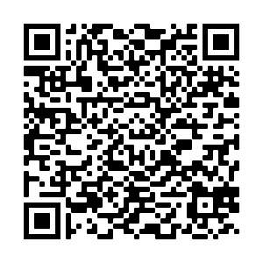
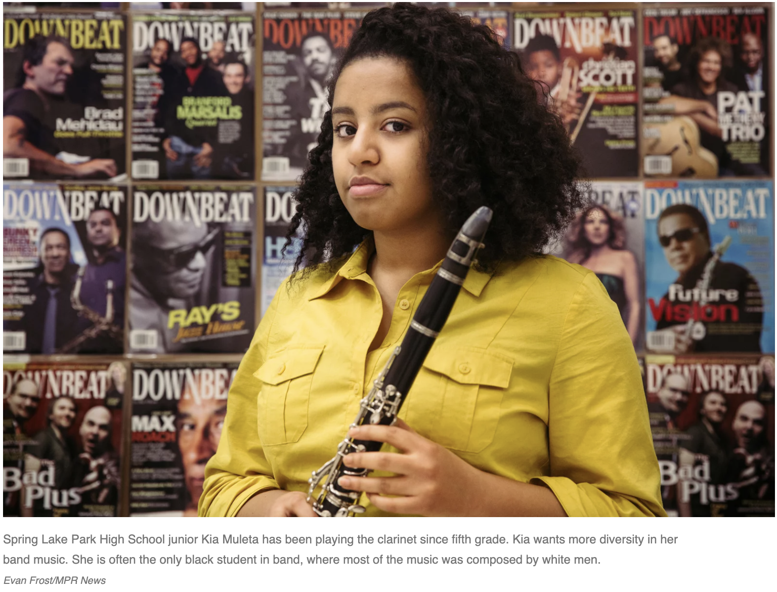
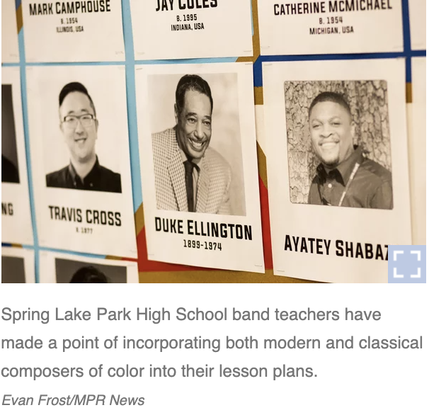
introduction
Why This High School Band Is Buying Music From Composers Of Color This Year, February 18, 2017, NPR Weekend Edition Saturday, Solvejg Wastvedt
Notes:
Introduction
I introduced the project by playing this clip from NPR – (listen) – I’m not sure after hearing that musician speak that I could provide any argument against why we should care about including music of underrepresented composers.

Slide 7
Who Is in our school?
PS Review 2017-18 | Niche ND | NYSED 2016-17
American Indian | Native American | American Indian or Alaska Native
Asian | Asian | Asian or Native Hawaiian/Other Pacific Islander
Hispanic | Hispanic | Hispanic or Latino
Hawaiian | Pacific Islander | Included above
Black | African American | African American
Two or more races | Multiracial | Multiracial
White | White | White
Notes:
Step 1
Niche included a category for unknown
Gender is almost 50/50 – Niche 51/49 (more female) NYSED 50/50

Slide 8
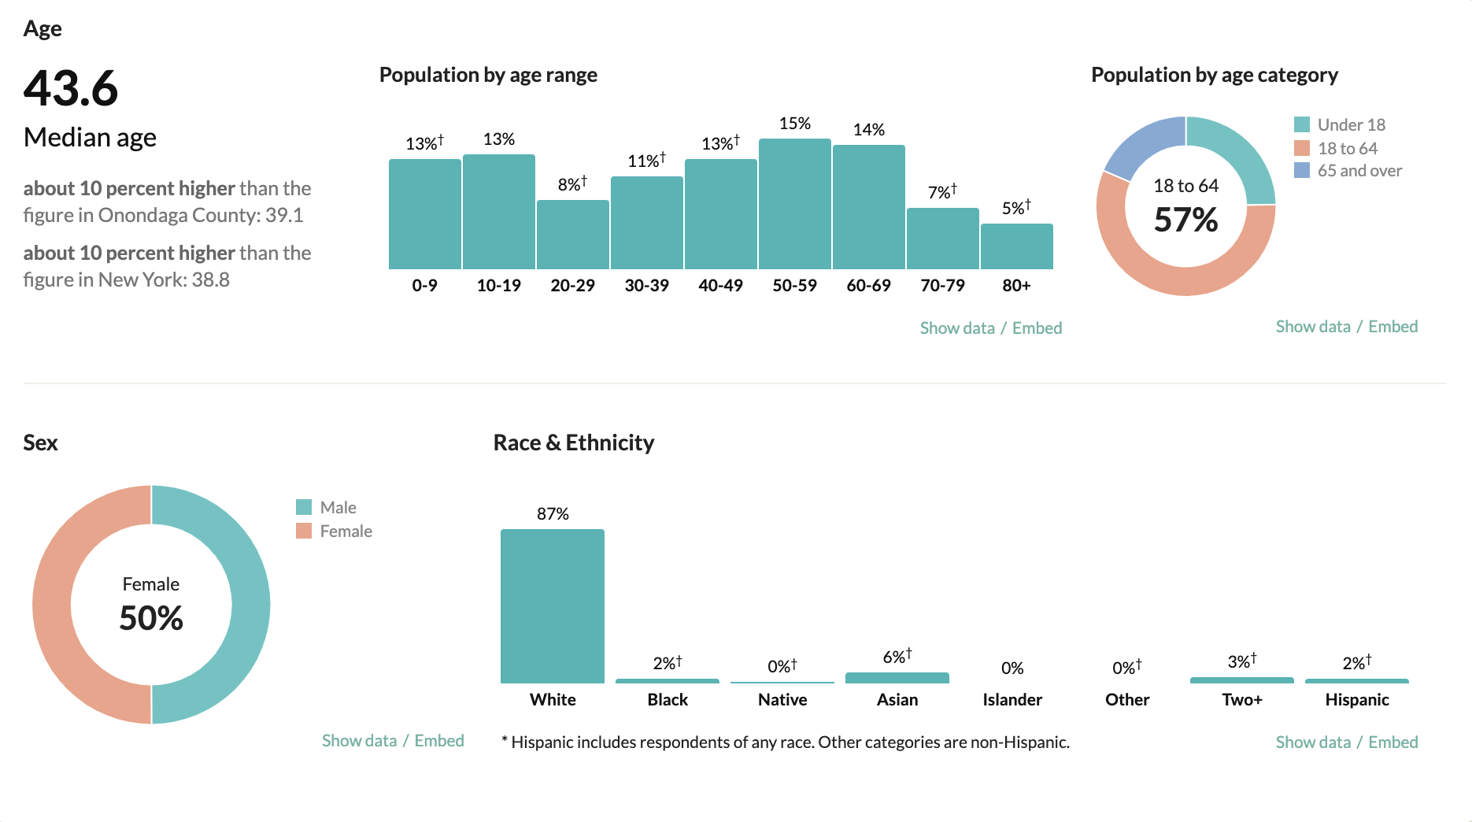
Notes:
Even the general census data is problematic (2019) – sex instead of gender – “other” for ethnicity, Hispanic encompasses all races

Slide 9
Who is in our ensemble?
The questions we asked:
Gender
Male
Female
Non-binary
Prefer not to answer
Ethnicity
American Indian or Alaska Native
Black or African American
Hispanic or Latino
Asian or Native Hawaiian/Other Pacific Islander
White
Multiracial
Other
If you checked “other” above or would like to more specifically describe your ethnicity, please do so below
Notes:
Step 2
Get permission from administration!

Slide 10
Who is in our Ensemble?
Notes:
Female – 15
Male – 10
Non-binary – 1
Prefer not to answer - 1

Slide 11
Who is in our ensemble?
Notes:
White – 18
Asian or Native Hawaiian/Other Pacific Islander – 5
Hispanic or Latino – 1
Black or African American – 1
American Indian or Alaskan Native – 1
Other – 1 (chose not to explain further)

Slide 12
Formalizing the project
Notes:
Step 3
We discussed the process as a class and I demonstrated the use of each different website. With the help of our school librarian, we took over the library computer lab (where she helped to guide them) and the adjoining computer labs (where I helped guide them). They were allowed to work collaboratively in teams – I assigned these teams based on grade level and instrument (to have an ”expert” on each team). However, they were encouraged to submit piece suggestions individually to make sure all the voices were heard.
To be clear, we were to choose 3 pieces to fill out a program in which I had already chosen one piece.

Slide 13
resources
Notes:
Institute - SUNY Fredonia - searchable database for band, orchestra, choir - can search by gender, ethnicity, etc.
And we were heard - database for instrumental - working on adding choir - has great graphics and data for state manuals and certain publishing houses - fantastic resource page
ColourFULL - Jodie Blackshaw - features programs with recordings of some prominent conductors (diverse) - features a pledge and a way to submit programs with recordings - also has a great resource page

Slide 14
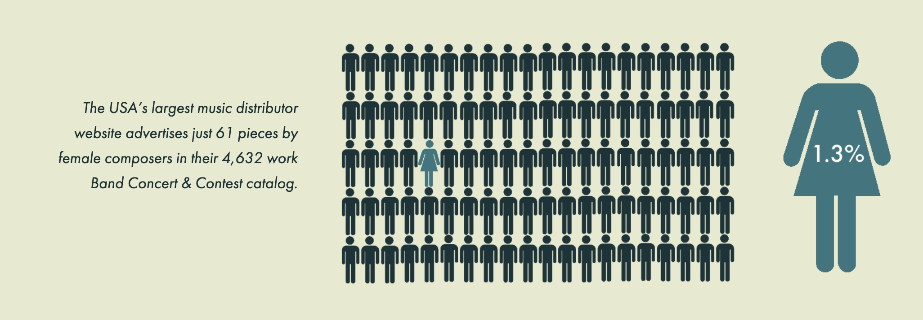
Compiling the results
From …And We Were Heard
Notes:
Step 4
Column descriptions
*Female composers listed with question mark until we could find they self-identified as female
*Pepper issues – if not carried by Pepper, must get a W9, a sole source form, and an invoice for PO – time again an issue
“I have contacted them about having all my music on their website, and they said they wanted 75% of any sales to collect payment, print and ship. They said they also wanted me to pay a yearly $100 fee to have access to add my own pieces to their website...so, they want me to pay them to do work on their website, so they can make sales. I find that ridiculous! I do have a third party arrangement for a few pieces as you can see – but even with that, I am still only collecting about a 40% profit off my own work.”
So here we have evidence of how good composers works may not be readily available and extra efforts may have to be made to find this music – there is probably a LOT of good music of which we are not aware.

Slide 15
voting

Slide 16
Results
Notes:
In Two Places from Haley
Vuelo – self-purchased
Merry Go Round – from Pepper
Already had the 4th piece to begin

Slide 17
The rehearsal process
Considered the meaning or story behind the music
Discussed how our performance practice could help convey that meaning
Teams of students reached out to composers
Teams of students put together biographical information for each composer and created display boards for the band room and to be used for the concert

Slide 18
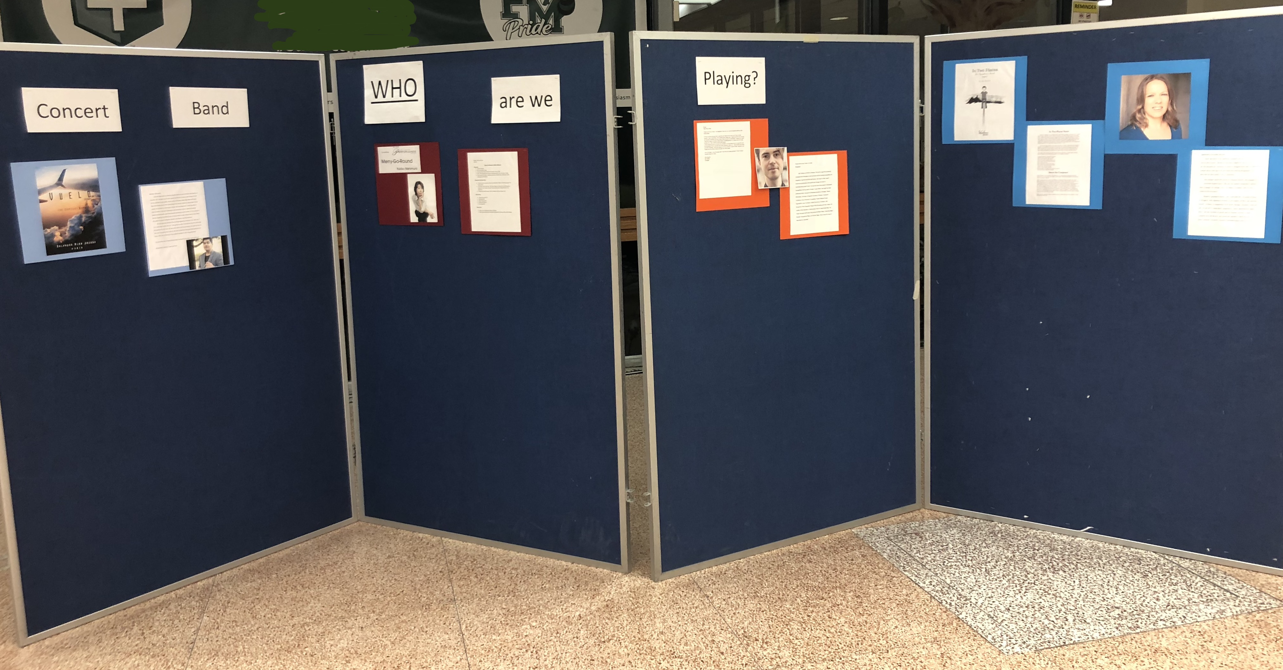
Concert night
Notes:
Email sent to parents to explain the concept of the concert and to encourage them to peruse the display boards. Many discussions on whether or not instrumental music could convey messages of social justice. The main takeaway was that awareness of the composer may help open doors to understanding how cultures can be similar, or how they may be unique, but still appreciated.

Slide 19
What now?
Continue to shift the thinking from “What are we playing?” to “Who are we playing?”
Create visual representations of composers to hang in the rehearsal room or hall
Normalize programming the music of diverse composers
Be aware of who the students are
Continue to make students an active participant in creating programming
Invite composers to speak/present/conduct as budgets allow
Notes:
Darryl Johnson, III

Slide 20
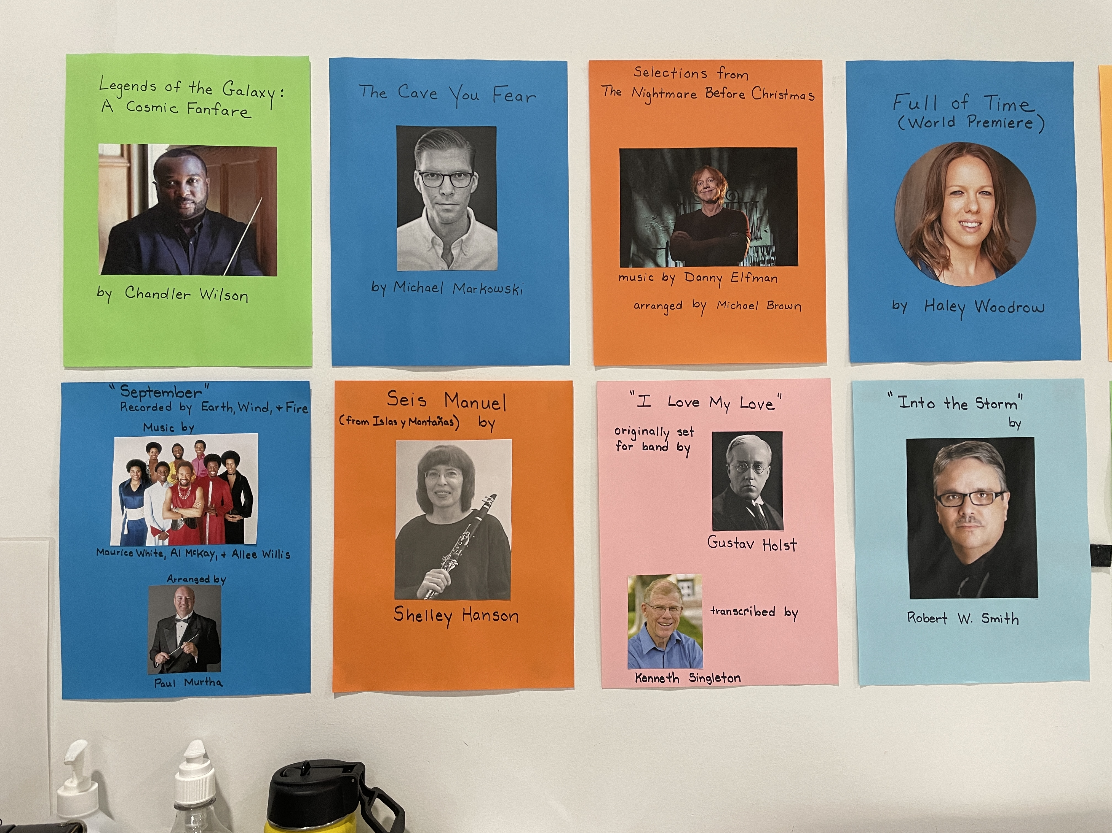
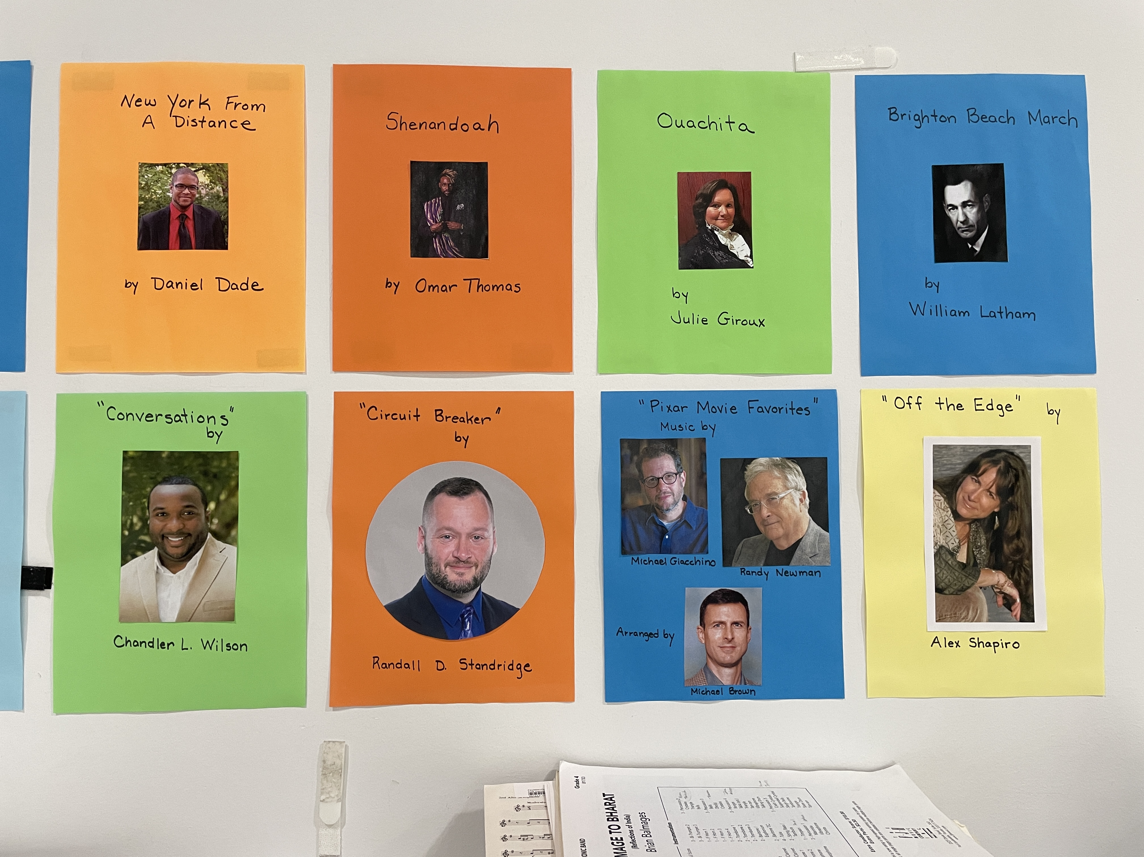
The band room wall

Slide 21
Questions?
jgreene@fmschools.org

